Slide 1
SSL Certificates for Secure Websites

Slide 2
What is SSL and what are Certificates?
The Secure Socket Layer protocol was created by Netscape to ensure secure transactions between web servers and browsers.
The protocol uses a third party, a Certificate Authority (CA), to identify one end or both end of the transactions.

Slide 3
How it works
A browser requests a secure page (usually https://).
The web server sends its public key with its certificate.
The browser checks that the certificate was issued by a trusted party (usually a trusted root CA), that the certificate is still valid and that the certificate is related to the site contacted.
The browser then uses the public key, to encrypt a random symmetric encryption key and sends it to the server with the encrypted URL required as well as other encrypted http data.
The web server decrypts the symmetric encryption key using its private key and uses the symmetric key to decrypt the URL and http data.
The web server sends back the requested html document and http data encrypted with the symmetric key.
The browser decrypts the http data and html document using the symmetric key and displays the information.

Slide 4
Two Features of
SSL Website Security
Encrypted data channel for privacy
SSL certificate for identity verification
  Is the organization who it claims to be?
  Is this a legitimate company?
Notes:
How do you know that you are dealing with the right person or rather the right web site. Well, someone has taken great length (if they are serious) to ensure that the web site owners are who they claim to be. This someone, you have to implicitly trust: you have his/her certificate loaded in your browser (a root Certificate). A certificate, contains information about the owner of the certificate, like e-mail address, owner's name, certificate usage, duration of validity, resource location or Distinguished Name (DN) which includes the Common Name (CN) (web site address or e-mail address depending of the usage) and the certificate ID of the person who certifies (signs) this information. It contains also the public key and finally a hash to ensure that the certificate has not been tampered with. As you made the choice to trust the person who signs this certificate, therefore you also trust this certificate. This is a certificate trust tree or certificate path. Usually your browser or application has already loaded the root certificate of well known Certification Authorities (CA) or root CA Certificates. The CA maintains a list of all signed certificates as well as a list of revoked certificates. A certificate is insecure until it is signed, as only a signed certificate cannot be modified. You can sign a certificate using itself, it is called a self signed certificate. All root CA certificates are self signed.
As You may have noticed, the certificate contains the reference to the issuer, the public key of the owner of this certificate, the dates of validity of this certificate and the signature of the certificate to ensure this certificate hasen't been tampered with. The certificate does not contain the private key as it should never be transmitted in any form whatsoever. This certificate has all the elements to send an encrypted message to the owner (using the public key) or to verify a message signed by the author of this certificate.

Slide 5
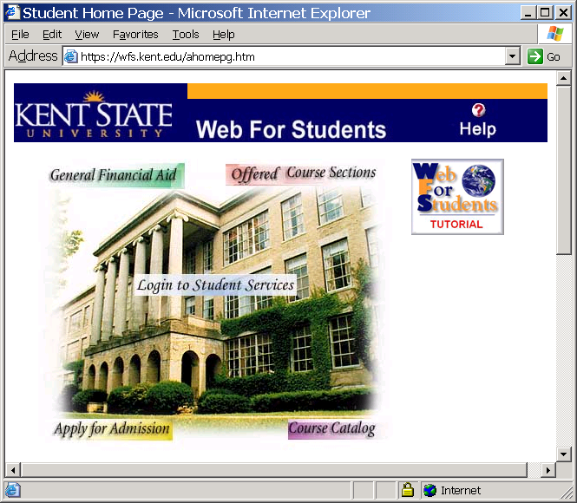
Website with
CA-signed SSL Certificate
“I am wfs.kent.edu.. you can verify my identity with VeriSign.”
Through your browser’s pre-established trust relationship with VeriSign, you automatically trust anyone who presents one of their certificates.

Slide 6
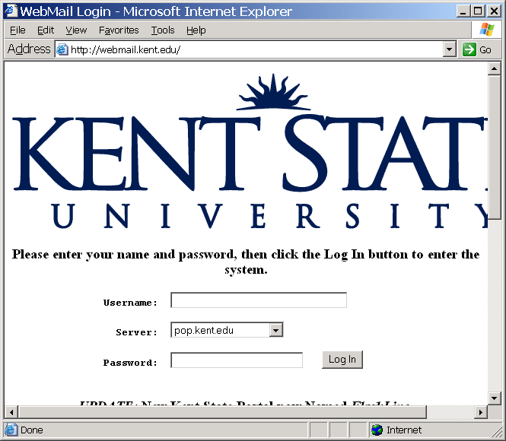
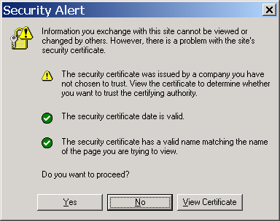
Website with
Self-signed SSL Certificate
“I am webmail.kent.edu.. you can verify my identity with webmail.kent.edu”
Since there is no pre-existing trust relationship with webmail.kent.edu in your browser, a security alert message appears.

Slide 7
Self-signed SSL Certificates
Free and unlimited supply
Only trust relationship between users and server already exists
Use for:
  Internal development
  Intranet applications

Slide 8
Self-signed SSL Certificates
Kent has its own self-signing Certification Authority (CA) at http://cert.kent.edu
  Installed on growing number of campus PCs
Certificate signing requests can be submitted to Greg Dykes or Dan Roberts

Slide 9
CA-signed SSL Certificates
Expensive (VeriSign $250-$400/cert per yr)
Useful when trust is not a given
  Allows user to verify your identity
  Eliminates warning message
Use for:
  Public-facing web sites
  Transactions involving commerce and/or exchange of personal information

Slide 10
When Can You Use a Self-Signed Certificate?
You can also use self-signed certificates for situations that require privacy, but people might not be as concerned about. For example:
  Username and password forms
  Collecting personal (non-financial) information
  On forms where the only users are people who know and trust you

Slide 11
If You're Doing Ecommerce You Need a Signed Certificate
If you're asking them to input their credit card or Paypal information, then you really need a signed certificate.
Most people trust the signed certificates and won't do business over an HTTPS server without one.
It's just a cost of doing business.

Slide 12
Alternative to VeriSign
GeoTrust
  Trusted root certification authority
  Same pre-established trust as VeriSign
  Managed PKI services with certificate request processing tools for supporting constituents
  Less cost (less than $150/cert per year)
  Quantity and multi-year discounts available
  Website: http://www.geotrust.com

Slide 13
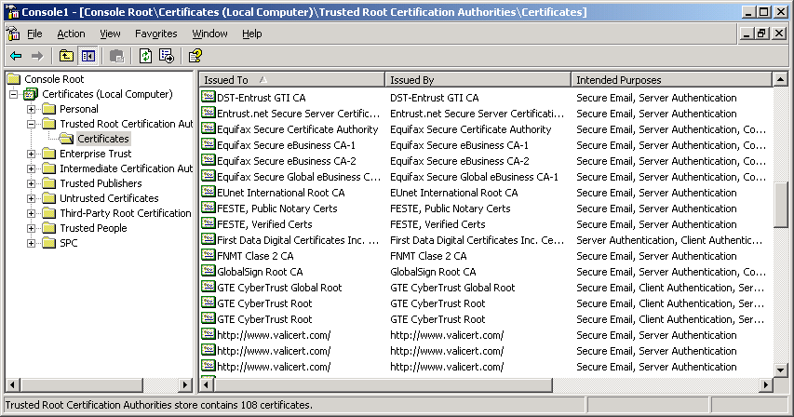
GeoTrust’s CA certificate
GeoTrust’s CA certificate has 99.9% browser penetration,
and appears in your computer’s Trusted Root Certification Authority container as “Equifax”

Slide 14
References
[1] Dan Roberts, SSL Certificates for Secure Websites
[2] http://www.tldp.org/HOWTO/SSL-Certificates-HOWTO/x64.html

